Slide 1



Noida Institute of Engineering and Technology, Greater Noida
JavaScript Essentials and ES6
Unit: 4
Web Technology (ACSE0505) )
Abdul Khalid
Assistant Professor
Information Technology
NIET, Greater Noida
Course Details (B Tech 5th Sem)

Slide 2

Table of Contents
Name of Subject with code, Course and Subject Teacher
Brief Introduction of Faculty member with Photograph
Evaluation Scheme
Subject Syllabus
Branch wise Applications
Course Objective (Point wise)
Course Outcomes (COs)
Program Outcomes only heading (POs)
COs and POs Mapping
Program Specific Outcomes (PSOs)
2

Slide 3
Conti….
COs and PSOs Mapping
Program Educational Objectives (PEOs)
Result Analysis (Department Result, Subject Result and Individual Faculty Result)
End Semester Question Paper Templates (Offline Pattern/Online Pattern)
Perquisite/ Recap
Brief Introduction about the Subject with videos
Unit Content
Unit Objective
Topic Objective/Topic Outcome
Lecture related to topic
Daily Quiz
Weekly Assignment

Slide 4
Conti…
Topic Links
MCQ (End of Unit)
Glossary Questions
Old Question Papers (Sessional + University)
Expected Questions
Recap of Unit

Slide 5
Brief Introduction of Faculty
I am pleased to introduce myself as Abdul Khalid, presently associated with NIET, Greater Noida as Assistant Professor in IT Department.
I completed my M.Tech. degree form Dr. A.P.J. Abdul Kalam Technical University, Lucknow (Formally known as Uttar Pradesh Technical University) in 2011. I have been working in NIET Greater Noida for last 12 years.
My area of interest is related to Software Engineering and Wireless Sensor Network.

Slide 6
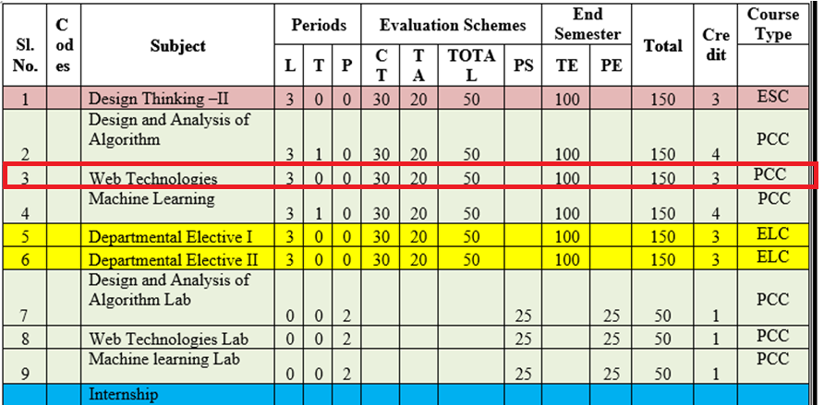
Evaluation Scheme

Slide 7
Syllabus Unit -1
Introduction: Introduction to Web Technology, History of Web and Internet, Connecting to Internet, Introduction to Internet services and tools, Client-Server Computing, Protocols Governing Web, Basic principles involved in developing a web site, Planning process, Types of Websites, Web Standards and W3C recommendations.
Web Hosting: Web Hosting Basics, Types of Hosting Packages, Registering domains, Defining Name Servers, Using Control Panel, Creating Emails in Cpanel, Using FTP Client, Maintaining a Website.

Slide 8
Syllabus Unit -2
HTML: What is HTML, DOM- Introduction to Document Object Model, Basic structure of an HTML document, Mark up Tags, Heading-Paragraphs , Line Breaks, Understand the structure of HTML tables. Lists, Working with Hyperlinks, Image Handling, Understanding Frames and their needs, HTML forms for User inputs. New form Elements- date, number, range, email, search and data list, Understanding audio, video and article tags.
XML: Introduction, Tree, Syntax, Elements, Attributes, Namespaces, Display, HTTP request, Parser, DOM, XPath, XSLT, XQuerry, XLink, Validator, DTD, Schema, Server

Slide 9
Syllabus Unit -3
Concept of CSS 3: Creating Style Sheet, CSS Properties,CSS Styling(Background, Text Format, Controlling Fonts) , Working with block elements and objects , Working with Lists and Tables , CSS Id and Class, Box Model(Introduction, Border properties, Padding Properties, Margin properties) CSS Advanced(Grouping, Dimension, Display, Positioning, Floating, Align, Pseudo class, Navigation Bar, Image Sprites, Attribute sector) , CSS Color, Creating page Layout and Site.
Bootstrap: Introduction, Bootstrap grid system, Bootstrap Components.

Slide 10
Syllabus Unit -4
JavaScript Essentials: Introduction to Java Script , Java script Types , Var, Let and Const Keywords, Operators in JS , Conditions Statements , Java Script Loops, JS Popup Boxes , JS Events , JS Arrays, Working with Arrays, JS Objects ,JS Functions , Using Java Script in Real time , Validation of Forms, Arrow functions and default arguments, Template Strings, Strings methods, Callback functions,
Object de-structuring, Spread and Rest Operator, Typescript fundamentals, Typescript OOPs- Classes, Interfaces, Constructor etc. Decorator and Spread Operator,
Difference == & ===, Asynchronous Programming in ES6, Promise Constructor, Promise with Chain, Promise Race.

Slide 11
Syllabus Unit -5
Introduction to PHP, Basic Syntax, Variables & Constants, Data Type, Operator & Expressions, Control flow and Decision making statements, Functions, Strings, Arrays,
Working with files and directories: Understanding file& directory, Opening and closing, a file, Coping, renaming and deleting a file, working with directories, Creating and deleting folder, File Uploading & Downloading.
Session & Cookies: Introduction to Session Control, Session Functionality What is a Cookie, Setting Cookies with PHP. Using Cookies with Sessions, Deleting Cookies, Registering Session variables, Destroying the variables and Session.

Slide 12
Text Books
Text books:
1. Steven M. Schafer, “HTML, XHTML, and CSS Bible, 5ed”, Wiley India
2. Ian Pouncey, Richard York, “Beginning CSS: Cascading Style Sheets for Web Design”, Wiley India

Slide 13
Branch Wise Applications
Sample Applications
Desktop GUI Applications
Mobile Applications
Enterprise Applications
Scientific Applications
Web-based Applications
Cloud-based Applications
Web servers and Application servers
Software Tools

Slide 14
Course Objective
This course covers different aspect of web technology such as HTML, CSS, and issues of web technology, client and server side issue.
The general objectives of this course are to provide fundamental concepts of Internet; Web Technology and Web Programming.
Students will be able to build a proper responsive website.

Slide 15
Course Outcome
At the end of the semester, student will be able to:
Course Outcomes (CO) | CO Description | Blooms’ Taxonomy
CO1 | Recalling the basic facts and explaining the basic ideas of Web technology and web hosting. | K2
CO2 | Applying and creating various HTML5 semantic elements and application with working on HTML forms for user input. | K6
CO3 | Understanding and applying the concepts of Creating Style Sheet (CSS)3 and bootstrap. | K3
CO4 | Analysing and implementing concept of Java Script and its applications. | K5
CO5 | Creating and evaluating dynamic web pages using the concept of PHP | K6

Slide 16
Program Outcome
1. Engineering knowledge:
2. Problem analysis:
3. Design/development of solutions:
4. Conduct investigations of complex problems:
5. Modern tool usage:
6. The engineer and society:
7. Environment and sustainability:
8. Ethics:
9. Individual and team work:
10. Communication:
11. Project management and finance:
12. Life-long learning

Slide 17
CO-PO Mapping
Mapping of Course Outcomes and Program Outcomes:
 | PO1 | PO2 | PO3 | PO4 | PO5 | PO6 | PO7 | PO8 | PO9 | PO10 | PO11 | PO12
ACSE0505 1.1 | 3 | 2 | 2 | 1 | 1 | 1 | 1 | 1 | 3 | 3 | 2 | 3
ACSE0505 1.2 | 3 | 2 | 3 | 1 | 3 | 2 | 2 | 1 | 3 | 3 | 3 | 3
ACSE0505 1.3 | 3 | 2 | 3 | 2 | 3 | 2 | 2 | 2 | 3 | 3 | 2 | 3
ACSE0505 1.4 | 3 | 3 | 3 | 2 | 3 | 2 | 2 | 2 | 3 | 3 | 2 | 3
ACSE0505 1.5 | 3 | 3 | 3 | 2 | 3 | 2 | 2 | 2 | 3 | 3 | 2 | 3
Average | 3 | 2.4 | 2.8 | 1.6 | 2.6 | 1.8 | 1.8 | 1.6 | 3 | 3 | 2.2 | 3

Slide 18
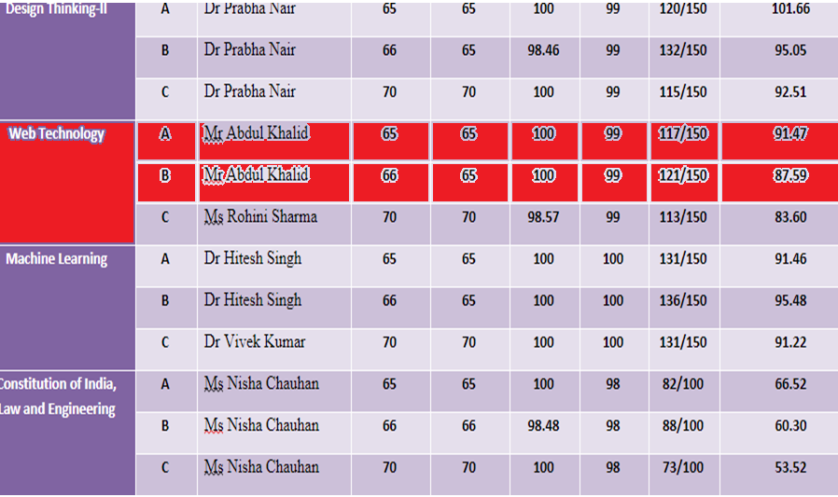
Result Analysis(2022-23)

Slide 19
Program Specific Outcomes
PSO1: Work as a software developer, database administrator, tester or networking engineer for providing solutions to the real world and industrial problems.
PSO2:Apply core subjects of information technology related to data structure and algorithm, software engineering, web technology, operating system, database and networking to solve complex IT problems.
PSO3:Practice multi-disciplinary and modern computing techniques by lifelong learning to establish innovative career.
PSO4: Work in a team or individual to manage projects with ethical concern to be a successful employee or employer in IT industry.

Slide 20
COs and PSOs Mapping
Mapping of Program Specific Outcomes and Course Outcomes:
Course Outcomes | Program Specific Outcomes
 | PSO1 | PSO2 | PSO3 | PSO4
CO1 | 3 | 3 | 2 | 3
CO2 | 3 | 3 | 3 | 2
CO3 | 3 | 3 | 2 | 2
CO4 | 3 | 2 | 3 | 2
CO5 | 3 | 2 | 2 | 2
AVG | 3 | 2.6 | 2.4 | 2.2

Slide 21
Program Educational Objectives
PEO1: able to apply sound knowledge in the field of information technology to fulfill the needs of IT industry.
PEO2:able to design innovative and interdisciplinary systems through latest digital technologies.
PEO3: able to inculcate professional and social ethics, team work and leadership for serving the society.
PEO4: able to inculcate lifelong learning in the field of computing for successful career in organizations and R&D sectors.

Slide 22
End Semester Question Paper Template
B TECH
(SEM-V) THEORY EXAMINATION 20__-20__
Time: 3 Hours Total Marks: 100
Note: 1. Attempt all Sections. If require any missing data; then choose suitably.
SECTION A
Attempt all questions in brief. 1 x 10 = 10
Q.No. | Question | Marks | CO
1 |  | 1
2 |  | 1
. |  | .
10 |  | 1

Slide 23
End Semester Question Paper Templates
2. Attempt of the following: 5 x 2 = 20
SECTION B
3. Attempt any five part of the following: 5 x 6 = 30
Q.No. | Question | Marks | CO
1 |  | 2
2 |  | 2
“”” |  | ‘”
5 |  | 2
Q.No. | Question | Marks | CO
1 |  | 6
. |  | 6
7 |  | 6

Slide 24
End Semester Question Paper Templates
4. Attempt any one part of the following: 1 x 10 = 10
5. Attempt any one part of the following: 1 x 10 = 10
6. Attempt any one part of the following: 1 x 10 = 10
Q.No. | Question | Marks | CO
1 |  | 10
2 |  | 10
Q.No. | Question | Marks | CO
1 |  | 10
2 |  | 10
Q.No. | Question | Marks | CO
1 |  | 10
2 |  | 10

Slide 25
End Semester Question Paper Templates
7. Attempt any one part of the following: 1 x 10 = 10
8. Attempt any one part of the following: 1 x 10 = 10
Q.No. | Question | Marks | CO
1 |  | 10
2 |  | 10
Q.No. | Question | Marks | CO
1 |  | 10
2 |  | 10

Slide 26
Prerequisite
Basic computer literacy, a basic understanding of HTML and CSS, familiarity with JavaScript
basicsBasic Knowledge of any programming language like C/C++/Python/Java.
Familiarity with basic concepts of Internet.

Slide 27
Brief Introduction About The Subject
Web technologies are the various tools and techniques that are utilized in the process of communication between different types of devices over the internet.
To understand this term in a better manner, let’s break it down into two pieces: ‘web’ and ‘technology’.
The web, in this case, refers to the World Wide Web, more commonly known as WWW.
It first came into being in 1989 when famous scientist and engineer, Tim Berners-Lee, came up with an efficient mechanism to share resources between scientists all over the world.
https://www.youtube.com/results?search_query=Web+Technonogies

Slide 28
Unit 4 Content
Introduction to Java Script ,
Java script Types , Var, Let and Const Keywords,
Operators in JS ,
Conditions Statements , Java Script Loops, JS Popup Boxes , JS Events ,
JS Arrays, Working with Arrays, JS Objects ,JS Functions ,
Using Java Script in Real time , Validation of Forms, Arrow functions and default arguments,
Template Strings, Strings methods, Callback functions,
Object de-structuring, Spread and Rest Operator, Typescript fundamentals, Typescript OOPs- Classes, Interfaces, Constructor etc. Decorator and Spread Operator,
Difference == & ===, Asynchronous Programming in ES6, Promise Constructor, Promise with Chain, Promise Race.

Slide 29
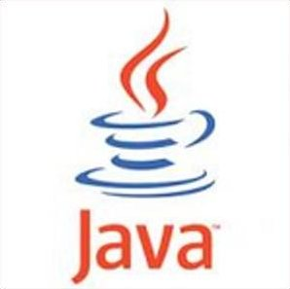
Unit 4 Objective
Objective of Unit 4:
To understand the basics of working with objects in JavaScript: creating objects, accessing and modifying object properties using constructors. understating various function, loop, array, string etc.

Slide 30
Topic Objective/Outcome
Topics: Introduction to Java Script , Java script Types , Var, Let and Const Keywords, Operators in JS , Conditions Statements , Java Script Loops, JS Popup Boxes , JS Events , JS Arrays, Working with Arrays, JS Objects ,JS Functions , Using Java Script in Real time , Validation of Forms, Arrow functions and default arguments, Template Strings, Strings methods, Call back functions. (CO4 )
Objective of the above topics:
To know the basics of difference between HTML,CSS and JavaScript
To get the knowledge about JAVA & JavaScript
To learn how various datatypes, variables, keywords, operators etc.
To learn various conditional statement, loop, types of function , how argument pass between function

Slide 31
Introduction to Java Script
JavaScript is a lightweight, interpreted programming language.
It is designed for creating network-centric applications
JavaScript is the world's most popular programming language.
JavaScript is the programming language of the Web.
JavaScript is easy to learn.
Abdul Khalid WT unit-4

Slide 32
Java Script cont…
Java Script is used insert dynamic text into HTML (ex: user name)
It’s get information about a user's computer (ex: browser type)
It perform calculations on user's computer (ex: form validation)
Java script offers a vast standard library that has a wide variety of functions and methods available to help in the process of development, making the entire process easier and hassle-free
Abdul Khalid WT unit- 4

Slide 33
Features of Java script
Javascript is a lightweight, cross-platform, and interpreted language.
It was developed with the main intention of DOM manipulation, bringing forth the era of dynamic websites.
Javascript functions are objects and can be passed in other functions as parameters.
Can handle date and time manipulation.
Can perform Form Validation.
A compiler is not needed.
Abdul Khalid WT Unit- 4

Slide 34

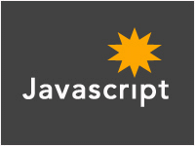
JAVA & Java Script
+
=
Abdul Khalid WT unit- 4

Slide 35
Self-Invoking Functions
Function expressions can be made "self-invoking".
A self-invoking expression is invoked (started) automatically, without being called.
Function expressions will execute automatically if the expression is followed by ().
You cannot self-invoke a function declaration.
we have to add parentheses around the function to indicate that it is a function expression:
Example
(function () { let x = "Hello!!"; // I will invoke myself })();

Slide 36
Javascript Syntax
Variables:-
variables are declared with the var keyword (case sensitive)
types are not specified, but JS does have types ("loosely typed")
Number, Boolean, String, Array, Object, Function, Null, Undefined
can find out a variable's type by calling typeof
var name = expression; JS
var clientName = "Connie Client";
var age = 32;
var weight = 127.4; JS
Abdul Khalid WT unit-4

Slide 37
Contd..
Number type
Vvvvvvvvvvvvvvvvvvvvvvvvvvvvvvvvvvvvvvvvvvvvvvvvvvvvvvvvvvvvvvvvvvvvvvvvvvvvvvvvvvvvvvvvvvvvvvvvvvvvvvvvvvvvvvvvvvvvvv
integers and real numbers are the same type (no int vs. double)
same operators: + - * / % ++ -- = += -= *= /= %=
similar precedence to Java
many operators auto-convert types: "2" * 3 is 6
var enrollment = 99;
var medianGrade = 2.8;
var credits = 5 + 4 + (2 * 3); JS
Abdul Khalid WT 4

Slide 38
Contd..
Comments (same as Java)
identical to Java's comment syntax
recall: 4 comment syntaxes
HTML: <!-- comment -->
CSS/JS/PHP: /* comment */
Java/JS/PHP: // comment
PHP: # comment
// single-line comment
/* multi-line comment */ JS
Pratik Singh 20CS603 and WT 4

Slide 39
Contd..
Math object
methods: abs, ceil, cos, floor, log, max, min, pow, random, round, sin, sqrt, tan
properties: E, PI
var rand1to10 = Math.floor(Math.random() * 10 + 1);
var three = Math.floor(Math.PI); JS
Pratik Singh and WT 4

Slide 40
Operators in JS
Logical operators
> < >= <= && || ! == != === !==
most logical operators automatically convert types:
5 < "7" is true
42 == 42.0 is true
"5.0" == 5 is true
=== and !== are strict equality tests; checks both type and value
"5.0" === 5 is false

Slide 41
Conditional statements
if/else statement (same as Java)
identical structure to Java's if/else statement
JavaScript allows almost anything as a condition
if (condition) {
statements;
} else if (condition) {
statements;
} else {
statements;
}
JS

Slide 42
Contd..
Boolean type
any value can be used as a Boolean
"falsey" values: 0, 0.0, NaN, "", null, and undefined
"truthy" values: anything else
converting a value into a Boolean explicitly:
var boolValue = Boolean(otherValue);
var boolValue = !!(otherValue);
var iLike190M = true;
var ieIsGood = "IE6" > 0; // false
if ("web devevelopment is great") { /* true */ }
if (0) { /* false */ } JS

Slide 43
Java script Loops
for loop (same as Java)
var sum = 0;
for (var i = 0; i < 100; i++) {
sum = sum + i;
} JS
var s1 = "hello";
var s2 = "";
for (var i = 0; i < s.length; i++) {
s2 += s1.charAt(i) + s1.charAt(i);
}
// s2 stores "hheelllloo" JS
Abdul Khalid WT Unit-4

Slide 44
Contd..
while loops (same as Java)
break and continue keywords also behave as in Java
while (condition) {
statements;
} JS
do {
statements;
} while (condition); JS

Slide 45
Daily Quiz
Q1. Java script is an _______ language?
(A) object oriented
(b) object base
© procedural
(d) None of these
Q2.Which of the following keywords is used to define a variable in JavaScript?
(a) let
(b) var
(C) both A & B
(d) None of the above
Q3.How can a datatype be declared to be constant type ?
(A) var
(b) const
© let
(D) constant

Slide 46
Daily Quiz(cont..)
Q4.Java script is ideal to
(A)make computations in HTML simpler
(B) minimize storage requirements on the web server
(c) increase the download time for the client
(D) none of the mentioned
Q5.The basic difference between javascript & java is
(A)There is no difference
(B). Functions are considered as fields
©. Variables are specific
(D). Functions are values, and there is no hard distinction between methods and fields
Q6. Which of the following is not javascript framework?
Node
Vue
React
Cassandra

Slide 47
Daily Quiz(cont..)
Q. 7 The three important manipulations done in a for loop on a loop variable?
a) Updation, Incrementation, Initialization
b) Initialization,Testing, Updation
c) Testing, Updation, Testing
d) Initialization,Testing, Incrementation
Q. 8 One of the special features of an interpreter in reference with the for loop is that ___________
a) Before each iteration, the interpreter evaluates the variable expression and assigns the name of the property
b) The iterations can be infinite when an interpreter is used
c) The body of the loop is executed only once
d) the iteration is finite when an interpreter is used
Q. 9 Among the keywords below, which one is not a statement?
a) debugger
b) with
c) if
d) use strict

Slide 48
Daily Quiz(cont..)
Q 10 What will be the output of the following JavaScript code?
var a = 10;
do {
a += 1;
console.log(a);
} while (a < 5);
a) 11121314
b) 1112
c) 12345
d) 11
Q 11 What will be the output of the following JavaScript code?
var a= 0;
var b = 0;
while (a < 3)
{
a++;
b += a;
console.log(b);
}
a) 135
b) 123
c) 013
d) 01

Slide 49
Daily Quiz(cont..)
Q 12 The expression scroe = scroe +10 can be written as
scrore += 10;
scroe ++= 10;
score =+ 10;
score + 10 = 10;
Q 13 The correct reslut of score = 2 + 4 + "3" is:
9
27
63
6
Q 14. Assignment Operators is following type of operator ______________.
None of these
Unarry
Binary
Ternary
Q 15 "Add and Assignment" operator is shown by this symbol.
==+
+==
=+
+=

Slide 50
Daily Quiz(Cont..)
Q 16. Among the following, which one is a ternary operator in JavaScript?
A. # B. ::
C. &: D. ?:
Q 17. What does javascript use instead of == and !=?
A. It uses bitwise checking B. It uses === and !== instead
C. It uses equals() and notequals() instead D. It uses equalto()
Q 18. What is the output of following Javascript? var a = 'letsfind'; var b = 'course'; var c = a/b; document.write(c);
A. Letsfindcourse B. letsfind/course C. NaN D. None of the above
Q 19. How ++ works in Javascript? Find output of below Javascript code.
A. 00 B. 01 C. 11 D. 10

Slide 51
Daily Quiz (Cont..)
Q 20. Which of the following method checks if its argument is not a number?
A. isNaN()
B. nonNaN()
C. NaN()
D. None of the above

Slide 52
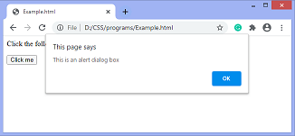
JS Popup boxes
alert
The alert() method in JavaScript is used to display a virtual alert box.
It is mostly used to give a warning message to the users.
Abdul Khalid WT Unit-4

Slide 53
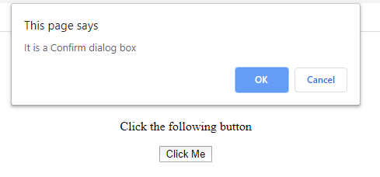
JS Popup boxes(cont..)
Confirmation
It is widely used for taking the opinion from the user on the specific option.
It includes two buttons, which are OK and Cancel. `
Abdul Khalid WT Unit-4

Slide 54
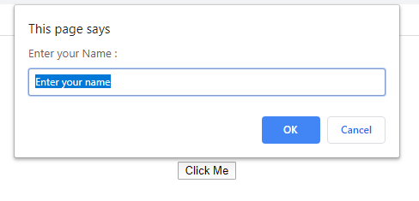
JS Popup boxes(cont..)
Prompt Dialog box
The prompt dialog box is used when it is required to pop-up a text box for getting the user input.
It enables interaction with the user.
Abdul Khalid WT Unit-4

Slide 55
Java script Events
The change in the state of an object is known as an Event.
represents that some activity is performed by the user or by the browser.
When javascript code is included in HTML, js react over these events and allow the execution.
Java Script handles the HTML events via Event Handlers.
Pratik Singh WT Unit-4

Slide 56
Common HTML Events
Common HTML Events
Event | Description
onchange | An HTML element has been changed
onclick | The user clicks an HTML element
onmouseover | The user moves the mouse over an HTML element
onmouseout | The user moves the mouse away from an HTML element
onkeydown | The user pushes a keyboard key
onload | The browser has finished loading the page
Pratik Singh WT Unit-4

Slide 57
JavaScript Event Handlers
Things that should be done every time a page loads
Things that should be done when the page is closed
Action that should be performed when a user clicks a button
Content that should be verified when a user inputs data
HTML event attributes can execute JavaScript code directly
HTML event attributes can call JavaScript functions
You can assign your own event handler functions to HTML elements
You can prevent events from being sent or being handled
Abdul Khalid WT Unit-4

Slide 58
JS Arrays
var name = []; // empty array
var name = [value, value, ..., value]; // pre-filled
name[index] = value; // store element JS
var ducks = ["Huey", "Dewey", "Louie"];
var stooges = []; // stooges.length is 0
stooges[0] = "Larry"; // stooges.length is 1
stooges[1] = "Moe"; // stooges.length is 2
stooges[4] = "Curly"; // stooges.length is 5
stooges[4] = "Shemp"; // stooges.length is 5 JS

Slide 59
Working with Arrays
array serves as many data structures: list, queue, stack, ...
methods: concat, join, pop, push, reverse, shift, slice, sort, splice, toString, unshift
push and pop add / remove from back
unshift and shift add / remove from front
shift and pop return the element that is removed
var a = ["Stef", "Jason"]; // Stef, Jason
a.push("Brian"); // Stef, Jason, Brian
a.unshift("Kelly"); // Kelly, Stef, Jason, Brian
a.pop(); // Kelly, Stef, Jason
a.shift(); // Stef, Jason
a.sort(); // Jason, Stef JS

Slide 60
Daily Quiz
Q 1 What are the types of Pop up boxes available in JavaScript?
Prompt
Alert
Confirm
All of the above
Q 2 Which of the following is the correct syntax to display “Tutoriallinks” in an alert box using JavaScript?
alertbox("Tutoriallinks");
message("Tutoriallinks");
alert(“Tutoriallinks”);
All of the above
Q 3 Which one of the following JavaScript statements produces the output as shown?
alert("Please Enter Your Name:", "Your Name");
confirm("Please Enter Your Name:", "Your Name");
alertbox("Please Enter Your Name:", "Your Name");
prompt("Please Enter Your Name:", "Your Name');

Slide 61
Daily Quiz(cont..)
Q 4. The type that specifies what kind of event occurred is ____________
a) event type
b) even target
c) both event type and even target
d) Interface
Q 5 Which is the object on which the event occurred or with which the event is associated?
a) event type
b) event target
c) both event type and even target
d) Interface
Q 6 In general, event handler is nothing but ____________
a) function
b) interface
c) event
d) Handler
Q 7 The property specifies the property of the event---------------
a) Type
b) Target
c) Manner
d) Program

Slide 62
Daily Quiz(cont..)
Q 8 The events that are directly tied to a specific input device are ____________
a) Device-independent input events
b) Device-dependent input events
c) User interface events
d) State change events
Q 9 ------------------form of event propagation handles the registered container elements
a) Event Propagation
b) Event Registration
c) Event Capturing
d) Default Actions
Q 10 The high-level events among the following events are ____________
a) User interface events
b) Device-independent events
c) Device-dependent events
d) Stage event change
Q 11 When will the browser invoke the handler?
a) Program begins
b) Any event occurs
c) Specified event occurs
d) Webpage loads

Slide 63
Daily Quiz(cont..)
Q 12 In JavaScript, an array can be created using the:
a. Array() constructor
b. [] literals
c. Both of the above
Q 13 How to access the second element of the array arr = [3, 7, 10]?
a. arr.indexOf(2)
b. arr.indexOf(1)
c. Carr[2]
d. arr[1]
Q 14 Arrays can have arrays as elements. True or false?
a. True
b. False
Q 15 Which property of array objects can be used to iterate over them?
a. length
b. len
c. Size
Q 16 The method or operator used to identify the array is __________
a) isarrayType()
b) ==
c) ===
d) typeof

Slide 64
Daily Quiz(cont..)
Q 17 The pop() method of the array does which of the following task?
a) decrements the total length by 1
b) increments the total length by 1
c) prints the first element but no effect on the length
d) updates the element
Q 18 What is the output?
const arr = ["Apple", "Banana", "Orange"];
console.log(arr["2"]);
a. undefined
b. "Orange"
c. TypeError: Invalid array index
d. "Banana“
Q 19 Which method removes the last element from an array and returns that element?
a. pop()
b. shift()
c. unshift()
d. slice()
Q 20 Which method adds a new item to the end of an array?
a. unshift()
b. slice()
c. push()
d. pop()

Slide 65
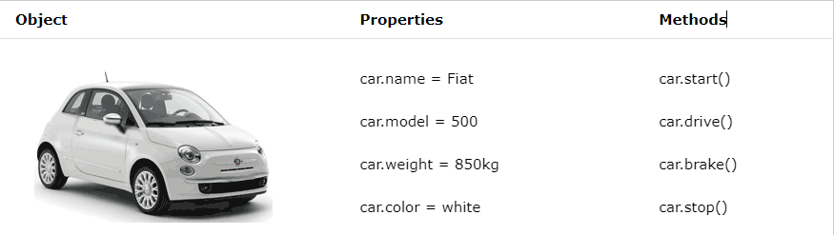
JavaScript Objects
Real Life Objects, Properties, and Methods
In real life, a car is an object. A car has properties like weight and color, and methods like start and stop:
All cars have the same properties, but the property values differ from car to car.
All cars have the same methods, but the methods are performed at different times.

Slide 66
JavaScript Objects
JavaScript Objects
This code assigns a simple value (Fiat) to a variable named car:
let car = "Fiat";
Objects are variables too. But objects can contain many values.
this code assigns many values (Fiat, 500, white) to a variable named car:
const car = {type:"Fiat", model:"500", color:"white"};
Object Definition
You define (and create) a JavaScript object with an object literal:
Example
const person = {firstName:"John", lastName:"Doe", age:50, eyeColor:"blue"};
Spaces and line breaks are not important. An object definition can span multiple lines:
const person = { firstName: "John", lastName: "Doe", age: 50, eyeColor: "blue" };

Slide 67
Contd….
Object Properties
The name : values pairs in JavaScript objects are called properties
Accessing Object Properties
You can access object properties in two ways:
objectName.propertyName
Object Methods
Objects can also have methods.
Methods are actions that can be performed on objects.
Methods are stored in properties as function definitions.
Property | Property Value
firstName | John
lastName | Doe
age | 50
eyeColor | blue

Slide 68
JavaScript Function Definitions
Javascript functions are defined with function keyword
You can use a function declaration or a function expression
Function Declarations
function functionName(parameters) { // code to be executed }
Declared functions are not executed immediately. They are "saved for later use", and will be executed later, when they are invoked (called upon).
function myFunction(a, b) { return a * b; }
Function Expressions
A JavaScript function can also be defined using an expression
A function expression can be stored in a variable:
const x = function (a, b) {return a * b};

Slide 69
Cont….
After a function expression has been stored in a variable, the variable can be used as a function:
const x = function (a, b) {return a * b}; let z = x(4, 3);
The function above is actually an anonymous function (a function without a name).
Functions stored in variables do not need function names. They are always invoked (called) using the variable name.
The Function() Constructor
Function can be defined with a built-in java script function constructor called function()
const myFunction = new Function("a", "b", "return a *b"); let x = myFunction(4, 3);

Slide 70
Self-Invoking Functions
Function expressions can be made "self-invoking".
A self-invoking expression is invoked (started) automatically, without being called.
Function expressions will execute automatically if the expression is followed by ().
You cannot self-invoke a function declaration.
we have to add parentheses around the function to indicate that it is a function expression:
Example
(function () { let x = "Hello!!"; // I will invoke myself })();
The function above is actually an anonymous self-invoking function (function without name)

Slide 71
Arrow Functions
Arrow functions allows a short syntax for writing function expressions.
Example :
// ES5 var x = function(x, y) { return x * y; } // ES6 const x = (x, y) => x * y;
Arrow functions do not have their own this. They are not well suited for defining object methods
Arrow functions are not hoisted. They must be defined before they are used
Using const is safer than using var, because a function expression is always constant value.
You can only omit the return keyword and the curly brackets if the function is a single statement. Because of this, it might be a good habit to always keep them:
Example
const x = (x, y) => { return x * y };

Slide 72
JavaScript Function Parameters
A JavaScript function does not perform any checking on parameter values (arguments).
function functionName(parameter1, parameter2, parameter3) { // code to be executed }
Function parameters are the names listed in the function definition.
Function arguments are the real values passed to (and received by) the function
Parameter Rules
JavaScript function definitions do not specify data types for parameters.
JavaScript functions do not perform type checking on the passed arguments.
JavaScript functions do not check the number of arguments received.
Default Parameters
If a function is called with missing arguments (less than declared), the missing values are set to undefined
function myFunction(x, y) { if (y === undefined) { y = 2; } }

Slide 73
Daily Quiz
Q 1 Which of the following is the literal way to create an object with a property x of value 10?
A. {x: 10}
B. new Object({x: 10})
Q 2 Suppose that obj is a pure JavaScript object. What will typeof obj return?
A. "object"
B. "obj"
C. "pure object“
Q 3 Objects can contain objects as property values. True or false?
A. True
B. False
Q 4 A method of an object is simply a property with a function definition as its value. True or false?
A. True
B. False
Q 5 What is the constructor way to create an empty object?
A. {}
B. new Object()

Slide 74
Daily Quiz(Cont..)
Q 6 JavaScript is a pure object-based language. True or false?
A. True
B. False
Q 7 Javascript is an _______ language.
object-oriented
Procedural
Object-based
Protype
Q 8 Object ......... is the process of converting an objects state to a string from which it can later be restored.
A. prototype
B. class
C. serialization
D. Extensible
Q 9 The ________ operator is used to create an instance of an object.
A. this
B. self
C. find
D. New
Q 10 JavaScript provides a special constructor function called Object() to build the object.
A. TRUE
B. FALSE

Slide 75
Daily Quiz(Cont..)
Q 12 Do functions in JavaScript necessarily return a value?
A. It is mandatory
B. Not necessary
C. Few functions return values by default
D. some functions do not return any value
Q 13 What will be the output of the following JavaScript code?
var string2Num=parseInt("123xyz");
A. 123
B. 123xyz
C. Exception
D. NaN
Q 14 Which of the following function of Number object returns the number's value?
A. toString()
B. valueOf()
C. toLocaleString()
D. toPrecision()
Q 15 What surrounds a string?
Quotations
Curly Brackets
Parenthesis
Square Brackets

Slide 76
Daily Quiz(Cont..)
Q 16 ........ functions need not allow invocations with zero arguments.
A. zero
B. strict
C. empty
D. Varargs
Q 17 A _________ is a group of reusable code which can be called anywhere in your program.
A. exception
B. function
C. loop
D. Switch
Q 18 The most common way to define a function in JavaScript is by using the ____________ keyword.
A. fun
B. var
C. function
D. Define
Q 19 JavaScript allows us to write our own functions as well(True/False)
A. True
B. False
Q 20 The Function() constructor expects ______ number of string arguments
A. 0
B. 1
C. 2
D. any

Slide 77
Topic Objective/Outcome
Topics: Object de-structuring, Spread and Rest Operator, Typescript fundamentals, Typescript OOPs- Classes, Interfaces, Constructor etc. Decorator and Spread Operator,
Difference == & ===, Asynchronous Programming in ES6, Promise Constructor, Promise with Chain, .(CO4 )
Objective of the above topics:
To learn the fundamentals of typescript
To learn the creation of object in ES6.
To get the knowledge about Programming in ES6.
To learn the OOPS concepts by using ES6 Programming.
To learn the concept of ES6 constructor chaning

Slide 78
TypeScript Fundamentals
TypeScript is an open-source language that provides support for building enterprise scale JavaScript applications. Although several patterns exist that can be used to structure JavaScript,
TypeScript is a programming language developed by Microsoft that is a superset of JavaScript. It is designed for developing enterprise scale JavaScript applications
TypeScript provides container functionality that object-oriented developers are familiar with, such as classes and modules.
It also supports strongly-typed code to ensure inappropriate values aren't assigned to variables in an application.

Slide 79
Difference between JavaScript & TypeScript
The main difference is that JavaScript is a scripting language used to make interactive web pages and applications, while TypeScript is a superset of JavaScript. Other differences include:
TypeScript code needs to be compiled, but JavaScript does not
TypeScript uses types and interfaces while JavaScript does not
TypeScript has some additional features for functions
TypeScript has a certain feature of prototyping that JS does not
Maintaining a huge code in JavaScript is extremely difficult.

Slide 80
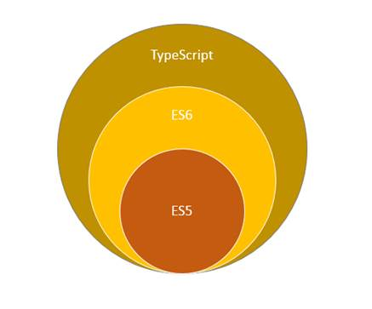
Key features of Typescript
TypeScript is a free and open-source programming language developed and maintained by Microsoft.
It is a superset of JavaScript, So you can write JavaScript code in typescript.
Enables static typing and class-based object-oriented programming to JavaScript.
Another key feature is that Angular 2 is written in typescript

Slide 81
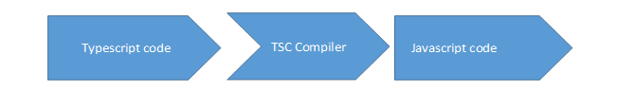
How typescript works
Typescript compiler converts code written in typescript to JavaScript,
Supported Editors We can write typescript using any one of the below editors.
Visual Studio.
Node.js
Sublime Editor
TypeScript play ground

Slide 82
Daily Quiz
Q 1 Which of the following best describes TypeScript?
a. A programming language
b. A markup language
c. A scripting language
d. A styling language
Q 2 What is the inherited type for the variable example in 'const example = ['Dylan']'?
A) any[]
B) string[]
C) string
D) unknown[]
Q 3 TypeScript will always correctly infer the type of an array.(True/False)
A)True
B)False
Q 4 .How many components typescript has?
A)3
B)4
C)5
D)6
Q 5 TypeScript supports how many types of comments
A)1
B)2
C)3
D)4

Slide 83
Daily Quiz(Cont..)
Q 6 TypeScript is a:
A. strongly typed
B. object oriented
C. compiled language
D. All of the above
Q 7 Which of the following are features of typeScript?
A. TypeScript is just JavaScript
B. TypeScript supports other JS libraries
C. TypeScript is portable
D. All of the above
Q 8 Extension of typescript is:
A. .d.ty
B. .d.tp
C. .d.ts
D. .d.td
Q 9 TypeScript supports Object Oriented Programming concepts like classes, interfaces, inheritance.
A. TRUE
B. FALSE
Q 10 Semicolons are optional in TypeScript.
A. Yes
B. No

Slide 84
Daily Quiz(Cont..)
Q 11 Which of the following companies has developed and designed TypeScript?
a. Amazon
b. TypeScript
c. Microsoft
d. Oracle
Q 12 What is the typing principle of typescript?
a. Gradual
b. Duck
c. Dynamic
d. All of the above
Q 13 Which of the computer programming languages below has influenced the creation of typescript?
a. JavaScript
b. Java
c. C#
d. All of the above
Q 14 What variable scopes are available in TypeScript?
a. Global Scope
b. Local Scope
c. Class Scope
d. All of the above
Q 15 What object oriented terms does Typescript support?
a. Interfaces
b. Classes
c. Modules
d. All of the above

Slide 85
Daily Quiz(Cont..)
Q 16. What are considered the types of access modifiers supported by TypeScript?
Public
Private
Protected
All of the above
Q 17 What does Typescript use for anonymous functions?
"dot" syntax
"arrow" syntax
none of the above
Q 18 A typescript may be installed or managed through…
Tag
Nmp
Space
Void
Q 19 What are the benefits of Typescript?
It helps in code structuring B. Use class based object oriented programming C. Impose coding guidelines D. All of the above
Q 20 TypeScript is :
A. case-sensitive
B. Case-insensitive
C. depends on typescript version
D. Can not say

Slide 86
Type Script Interfaces
Interface is a structure that defines the contract in your application.
It defines the syntax for classes to follow.
Classes that are derived from an interface must follow the structure provided by their interface.
The TypeScript compiler does not convert interface to JavaScript.
It uses interface for type checking. This is also known as "duck typing" or "structural subtyping“
An interface is defined with the keyword interface and it can include properties and method declarations using a function or an arrow function.

Slide 87
Type Script Interfaces(cont..)
Example: Interface
interface IEmployee {
empCode: number;
empName: string;
getSalary: (number) => number; // arrow function
getManagerName(number): string;
}

Slide 88
Interface as Type
Interface in TypeScript can be used to define a type and also to implement it in the class.
The following interface IEmployee defines a type of a variable.
Example: Interface as Type Copy
interface KeyPair {
key: number;
value: string;
}
let kv1: KeyPair = { key:1, value:"Steve" }; // OK
let kv2: KeyPair = { key:1, val:"Steve" }; // Compiler Error: 'val' doesn't exist in type 'KeyPair'
let kv3: KeyPair = { key:1, value:100 }; // Compiler Error:

Slide 89
Interface as Type(cont..)
Interface as Function Type
TypeScript interface is also used to define a type of a function.
This ensures the function signature.
Example: Function Type Copy
interface KeyValueProcessor
{
(key: number, value: string): void;
};
function addKeyValue(key:number, value:string):void {
console.log('addKeyValue: key = ' + key + ', value = ' + value)
}
function updateKeyValue(key: number, value:string):void {
console.log('updateKeyValue: key = '+ key + ', value = ' + value)
}

Slide 90
Interface as Type(cont..)
Interface as Function Type
TypeScript interface is also used to define a type of a function.
This ensures the function signature.
Example: Function Type Copy
interface KeyValueProcessor
{
(key: number, value: string): void;
};
function addKeyValue(key:number, value:string):void {
console.log('addKeyValue: key = ' + key + ', value = ' + value)
}
function updateKeyValue(key: number, value:string):void {
console.log('updateKeyValue: key = '+ key + ', value = ' + value)
}

Slide 91
Constructor in TypeScript
A constructor is a special function of the class that is automatically invoked when we create an instance of the class in Typescript.
We use it to initialize the properties of the current instance of the class.
Using the constructor parameter properties or Parameter shorthand syntax, we can add new properties to the class.
We can also create multiple constructors using the technique of constructor method overload.

Slide 92
Creating a Class Constructor
The constructor method in a class must have the name constructor.
A class can have only one implementation of the constructor method.
The constructor method is invoked every time we create an instance from the class using the new operator.
It always returns the newly created object.

Slide 93
Example of Constructor
class Person {
constructor() {
console.log("Constructor is called")
}
}
let p1= new Person() //contructor is called
let p2= new Person() //contructor is called

Slide 94
Parameters to the Constructor method
Constructors are just like normal functions in the way that they also accept parameters.
We need to pass parameter values when we create a new class instance.
Example:
class Person {
firstName:string;
lastName:string;
constructor(fName:string, lName:string) {
this.firstName=fName;
this.lastName=lName;
}
}

Slide 95
Daily Quiz
Q 1 An Interface is a structure which acts as a contract in our application(True/False)
True
False
Q 2 The TypeScript compiler uses interface for type-checking (also known as "duck typing" or "structural subtyping")(True/False)
True
False
Q 3 The interface contains only the declaration of the methods and fields, but also the implementation(True/False)
True
False
Q 4 An interface is a keyword which is used to declare a TypeScript Interface.(True/False)
True
B. False
Q 5 We can inherit the interface from the other interfaces by using ‘entends’ keyword(True/False)
True
B. False
Q 6 We can use interfaces to describe the array type(Right/Wrong)
Right
Wrong
Q 7 Interface defines the required functions, and the class is responsible for implementing it to meet that contract(True/False)
True
False

Slide 96
Daily Quiz(Cont..)
Q 8 An interface type objects cannot declare any new methods or variables.(T/F)
True.
False
Q 9 In Typescript Interface are classes that contain body-less structure (abstract or virtual functions) (True/False)
True
False
Q 10 Interface enforces the variables and methods which have not to be present in an object.(True/False)
True
False
Q 11 TypeScript also allows us to use the interface in a class(True/False)
True
B. False
Q 12 When the Typescript compiler compiles it into JavaScript, then the interface will be disappeared from the JavaScript file(True/False)
True
False

Slide 97
Daily Quiz(Cont..)
Q 13 class Bird {
Bird () {console.log(“I am Bird”);}}
What will be output of : var obj=new Bird();?
a.Error
b.I am Birdc.
c. Bird am I
d. None of these
Q 14 ________ an interface will have the same properties as that interface.
A)Idolizing
B)Improving
C)Extending
D)Duplicating
Q 15 The constructor method is invoked every time we create an instance from the class using the new operator. (True/False)
True
False
Q 16 Constructor need to pass parameter values when we create a new class instance.(True/False)
A. True
B. False
Q 18 The constructor method in a class must have the name constructor and not always returns the newly created object(True/False)
True
False

Slide 98
Daily Quiz(Cont..)
Q 19 How can you call base class constructor in Typescript?
By using base()
By using super()
Q 20 With a constructor on the interface, you can specify that all of your types must have certain methods/properties(True/False)
True
False
Q 21 TypeScript interface is not used to define a type of a function(True/False)
True
B. False
Q 22 Can you have multiple constructor implementation in Typescript?(Yes/No)
Yes.
No.
Q 23 Constructors are identified with the keyword "constructor" in Typescript(Right/Wrong)
Right
Wrong
Q 24 A constructor is a special function of the class that is responsible for initializing the variables of the class(True/False)
True
B. False
Q 25 Constructor is special type of function that always has a return type(Right/Wrong)
Right
B. Wrong

Slide 99
TypeScript Decorators
A Decorator is a special kind of declaration that can be applied to classes, methods, accessor, property, or parameter.
Decorators are simply functions that are prefixed @expression
symbol, where expression must evaluate to a function that will be called at runtime with information about the decorated declaration.
Decorators are an experimental feature proposed for ES7.
It is already in use by some of the JavaScript frameworks including Angular 2.
TypeScript Decorators serves the purpose of adding both annotations and metadata to the existing code in a declarative way.

Slide 100
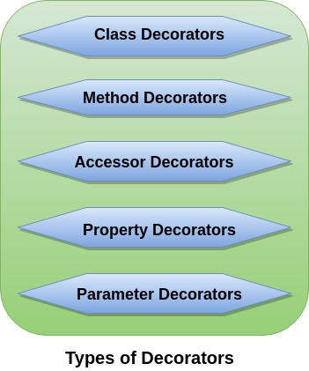
Types of Decorators

Slide 101
Types of Decorators(cont..)
Class Decorators
A class decorator is defined just before the class declaration, and it tells about the class behaviors.
A class decorator is applied to the constructor of the class.
A class decorator can be used to observe, modify, or replace a class definition.

Slide 102
Types of Decorators(cont..)
Example of Class Decorators:
@sealed
class Person {
msg: string;
constructor(message: string) {
this.msg = message;
}
show()
{
return "Hello, " + this.msg;
}
}

Slide 103
Types of Decorators(cont..)
Method Decorators
A Method Decorator is defined just before a method declaration.
It is applied to a property descriptor for the method. It can be used to observe, modify, or replace a method definition.
We cannot use method decorator in a declaration file.
The expression for the method decorator function accepts three arguments.

Slide 104
Types of Decorators(cont..)
Example of Method Decorators
class Item {
itemArr: Array;
constructor() {
this.itemArr = [];
}
@log
Add(item: string): void {
this.itemArr.push(item);
}
GetAll(): Array {
return this.itemArr;
}
}

Slide 105
Types of Decorators(cont..)
Accessor Decorators
An Accessor Decorator is defined just before an accessor declaration.
It is applied to the property descriptor for the accessor.
It can be used to observe, modify, or replace an accessor's definitions.
An accessor is a getter and setter property of the class declaration.

Slide 106
Types of Decorators(cont..)
Example of Accessor Decorators
class Employee {
private _salary: number;
private _name: string;
@configurable(false)
get salary() { return 'Rs. ${this._salary}'; }
set salary(salary: any) { this._salary = +salary; }
@configurable(true)
get name() { return 'Sir/Madam, ${this._name}'; }
set name(name: string) { this._name = name; }
}

Slide 107
Types of Decorators(cont..)
Property Decorators
A property decorator is defined just before a property declaration.
It is similar to the method decorators.
The only difference between property decorators and method decorators is that they do not accept property descriptor as an argument and do not return anything.

Slide 108
Types of Decorators(cont..)
Example of Property Decorators
class Company {
@ReadOnly
name: string = “NIET";
}
let comp = new Company();
comp.name = 'SSSIT.com'; console.log(comp.name);

Slide 109
Types of Decorators(cont..)
Parameter Decorators
A parameter decorator is defined just before a parameter declaration.
It is applied to the function for a class constructor or method declaration.
It cannot be used in a declaration file or in any other ambient context (such as in a declared class).

Slide 110
Types of Decorators(cont..)
Example of Parameter Decorators
class Person {
msg: string;
constructor(message: string) {
this.msg = message;
}
@validate
show(@required name: string) {
return "Hello " + name + ", " + this.msg;
}
}

Slide 111
Daily Quiz
Q 1 Using what can we modify the behaviour of a class?
party decorators
property decorators
class modifyer
class decorators
Q 2 Which of these is a backported feature of TypeScript?
arrow
methods
modules
classes
Q 3 A Decorator is a special kind of declaration that can be applied to classes, methods, accessor, property, or parameter(True/False)
True
False
Q 4 Decorators are simply functions that are prefixed expression symbol
#
&
@
Q 5 Decorators are an experimental feature proposed for ES6(True/False)
True
False

Slide 112
Daily Quiz(Cont..)
Q 6 A class decorator is defined just before the class declaration, and it tells about the method behaviors(True/False)
True
False
Q 7 A class decorator is applied to the ---------------- of the class.
Method
Constructor
Variable
Q 8 Method Decorators is applied to a ----------------- descriptor for the method
Parameter
Method
Property
Q 9 The expression for the method decorator function accepts------------ arguments.
One
Two
Three
Four
Q 10 An Accessor Decorator is defined just before a mutator declaration (True/False)
True
False

Slide 113
Daily Quiz(Cont..)
Q 11 An accessor is a getter and setter property of the class declaration.(True/False)
True
False
Q 12 Property Decorator is similar to the--------- decorators
Class
Method
Accessor
Q 13 The only difference between property decorators and method decorators is that they do not accept property descriptor as an argument and always return anything(True/False)
True
False
Q 14 Parameter Decorator is applied to the function for a class constructor or method declaration. (True/False)
True
False
Q 15 A parameter decorator is defined just before a----------- declaration.
Class
Method
Property
Parameter

Slide 114
ES6 Spread Operator
ES6 introduced a new operator referred to as a spread operator, which consists of three dots (...).
It allows an iterable to expand in places where more than zero arguments are expected.
It gives us the privilege to obtain the parameters from an array.
Syntax:
var variablename1 = [...value];
The three dots (...) in the above syntax are the spread operator, which targets the entire values in the particular variable.

Slide 115
Spread Operator and Array Manipulation
Example
let colors = ['Red', 'Yellow'];
let newColors = [...colors, 'Violet', 'Orange', 'Green'];
console.log(newColors);
Output
[ 'Red', 'Yellow', 'Violet', 'Orange', 'Green' ]

Slide 116
Without using spread operator
let colors = ['Red', 'Yellow'];
let newColors = colors;
newColors.push('Green');
console.log(newColors);
console.log(colors);
Output:
[ 'Red', 'Yellow', 'Green' ]
[ 'Red', 'Yellow', 'Green' ]

Slide 117
Using spread operator
let colors = ['Red', 'Yellow'];
let newColors = [...colors];
newColors.push('Green');
console.log(newColors);
console.log(colors);
Output
[ 'Red', 'Yellow', 'Green' ]
[ 'Red', 'Yellow'

Slide 118
Daily Quiz
Q 1 The term 'Spread Operator' can be defined as an operator that allows expending the array into separate elements.
Two Dot(..)
Three Dot(…)
Four Dot(….)
Q 2 The Spread Operator is the concepts of--------------
Java Script
Type Script
ES6
ES7
Q 3 Spread Operator allows an iterable to expand in places where more than zero arguments are expected(True/False)
True
B. False
Q 4 Spread Operator does not give us the privilege to obtain the parameters from an array.(True/False)
True
False
Q 5 Spread operator does not make changes in the original array it also does operations in the spread operator(True/False)
True
False

Slide 119
Daily Quiz(Cont..)
Q 6 Spread Operator is a very simple and powerful feature introduced in the ES6 standard of-------------
VBScript
TypeScript
Node.JS
Java Script
Q 7 The Spread operator allows an iterable to expand in places where 0+ arguments are expected. (True/False)
True
False
Q 8 Spread operator is mostly used in the variable array where there is more than 1 value is expected. (Right/Wrong)
Right
Wrong
Q 9 Spread operator can not be used in many cases, like when we want to expand, copy, concat, with math object(True/False)
True
False
Q 10 Spread operator syntax is similar to the-----------parameter
Expand
Iterate
rest

Slide 120
Strict Equality (==) Loose Equality (===) in Typescript
The Typescript has two operators for checking equality.
One is == (equality operator or loose equality operator) and the other one is === (strict equality operator).
Both of these operators check the value of operands for equality.
But, the difference between == & === is that the == does a type conversion before checking for equality.

Slide 121
Checking Equality
Two values are equal if they are
identical strings
numerically equivalent numbers
identical Boolean values
the same object (reference types)
Example:
let a=10
let b=10
console.log(a==b) //true
console.log(a===b) //true

Slide 122
Difference between == & ===
If types are same then there is no difference between == & ===
If types are different then == does a type conversion.
It will attempt to convert them to a string, number, or boolean. before doing the comparison.
=== returns false.

Slide 123
Equality Operator ==
let a=10
let b=10
console.log(a==b) //true
But, in the following code, the variable b is a string and not a number.
The Typescript makes the type conversion of b from string to number and then does the comparison. Hence the result is true again.
let a=10
let b="10"
console.log(a==b) //true
let a="01"
let b=1
console.log(a==b);//true

Slide 124
Strict Equality Operator ===
The strict Equality operator, returns false if the types are different.
let a=10
let b=10
console.log(a===b) //true
let a=10
let b="10“
console.log(a===b) //false

Slide 125
Daily Quiz(Cont..)
Q 1 What return the following code?
let a=10
let b=10
console.log(a==b)
console.log(a===b)
true
false
Compile Error
Q 2 If types are same then there is no difference between == & ===(True/False)
True
False
Q 3 What return the following code?
let a=“01”
let b=1
console.log(a==b)
true
false
Compile Error
Q 4 What return the following code?
let a=“10”
let b=10
console.log(a===b)
true
false
Compile Error

Slide 126
Daily Quiz(Cont..)
Q 5 What return the following code?
let a=20
let b=20
console.log(a===b)
true
false
Compile Error
Q 6 Equality Operator does not check the type of the operand. It tries to convert them to string, number, or Boolean.(True/False)
True
False
Q 7 The strict Equality operator, returns false if the types are different.(True/False)
True
False
Q 8 The output of console.log(NaN==NaN); is:
true
false
Q 9 The output of console.log(-0==0); is:
true
false
Q 10 The output of console.log(null==undefined); is:
true
false

Slide 127
JavaScript ES6
JavaScript ES6 (also known as ECMAScript 2015 or ECMAScript 6) is the newer version of JavaScript that was introduced in 2015
ECMAScript 2015 or ES2015 is a significant update to the JavaScript programming language. It is the first major update to the language since ES5 which was standardized in 2009. Therefore, ES2015 is often called ES6.
ECMAScript is the standard that JavaScript programming language uses. ECMAScript provides the specification on how JavaScript programming language should work.

Slide 128
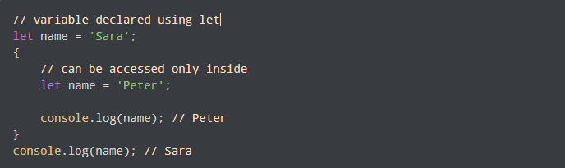
ES6 Cont…
JavaScript let
JavaScript let is used to declare variables. Previously, variables were declared using the var keyword
The variables declared using let are block-scoped. This means they are only accessible within a particular block. For example,

Slide 129

ES6 Cont…
JavaScript const
The const statement is used to declare constants in JavaScript. For example,
Once declared, you cannot change the value of a const variable

Slide 130
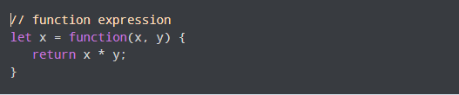

ES6 Cont…
JavaScript Arrow Function
In the ES6 version, you can use arrow functions to create function expressions. For example,
This function
can be written as

Slide 131
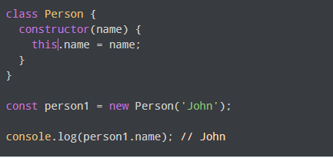
ES6 Cont…
JavaScript Classes
JavaScript class is used to create an object. Class is like a constructor function. For example,
class Person {
constructor(name) {
this.name = name;
}
}
Keyword class is used to create a class. The properties are assigned in a constructor function. Now you can create an object.

Slide 132
Asynchronous Programming in ES6
ES6 makes asynchronous programming easier with the async and await keywords.
The async...await syntax in ES6 offers a new way write more readable and scalable code to handle promises.
It uses the same features that were already built into JavaScript.
Promises.all() provides a means of corralling several asynchronous methods into an array of results that we can then iterate over for additional processing.

Slide 133
Daily Quiz
Q 1 ECMAScript is a __________Standard
Language
Java Script
Programming
Q 2 ES6 is the implementation of----------------
Java Script
Type Script
VBScript
ECMAScript
Q 3 ES6 is officially called ______________
Java Script 2015
VBScript 2016
ECMAScript 2015
Q 4 ES6 can be used for ______________
Client-side
Server-Side
Both client side and server side scription
Q 5 During destructuring, you can either declare variables or assign to them, or both(True/False)
True
False
Q 6 ECMAScript was created to standardize JavaScript, and ES6 is the 6th version of ECMAScript(True/False)
True
False

Slide 134
Daily Quiz(Cont..)
Q 7 ES6 makes asynchronous programming easier with the async keyword only(True/False)
True
False
Q 8 ES6 uses the same features that were already built into JavaScript(True/False)
True
False
Q 9 Promises.all() provides a means of corralling several asynchronous methods into an array of results that we can then iterate over for additional processing.(True/False)
True
False
Q 10 JavaScript ES6 is nothing but the 6th version of JavaScript introduced in 2015(Right/Wrong)
Right
Wrong
Q 11 It is mandatory to use the function keyword for defining functions in ES6(True/False)
True
False
Q 12 It is also mandatory to use the return keyword for defining functions in ES6(True/False)
True
False
Q 13 ES6 shows relatively higher performance.(True/False)
True
False

Slide 135
ES6 Promises
A Promise represents something that is eventually fulfilled.
A Promise can either be rejected or resolved based on the operation outcome.
ES6 Promise is the easiest way to work with asynchronous programming in JavaScript.
Asynchronous programming includes the running of processes individually from the main thread and notifies the main thread when it gets complete.
Prior to the Promises, Callbacks were used to perform asynchronous programming.

Slide 136
ES6 Promises(Cont..)
A Callback is a way to handle the function execution after the completion of the execution of another function.
A Callback would be helpful in working with events. In Callback, a function can be passed as a parameter to another function.

Slide 137
ES6 Promises(Cont..)
Creating a Promise
In JavaScript, we can create a Promise by using the Promise() constructor.
Syntax
const Promise = new Promise((resolve,reject) => {....});

Slide 138
ES6 Promises(Cont..)
Example of Promise Constructor
let Promise = new Promise((resolve, reject)=>{
let a = 3;
if(a==3){
resolve('Success');
}
else{
reject('Failed');
}
})
Promise.then((message)=>{
console.log("It is then block. The message is: ?+ message)
}).catch((message)=>{
console.log("It is Catch block. The message is: ?+ message)
})
Output
It is then block. The message is: Success

Slide 139
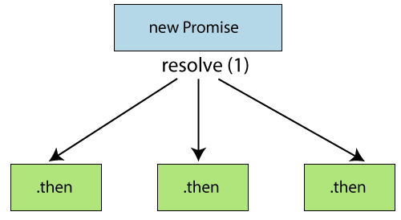
Promise with Chaining
Promise chaining allows us to control the flow of JavaScript asynchronous operations.
By using Promise chaining, we can use the returned value of a Promise as the input to another asynchronous operation

Slide 140
Promise with Chaining(cont..)
Sometimes, it is desirable to chain Promises together.
For example, suppose we have several asynchronous operations to be performed. When one operation gives us data, we will start doing another operation on that piece of data and so on.
Promise chaining is helpful when we have multiple interdependent asynchronous functions, and each of these functions should run one after another.

Slide 141
Promise with Chaining(cont..)
Example:
<script>
let promise_variable = new Promise((resolve, reject) => {
resolve("JavaScript chaining");
});
promise_variable
.then( function (resultInfo1){
console.log(resultInfo1);
return new Promise((resolve,reject) =>{
resolve("JavaTpoint");
})
})
.then((resultInfo2) => {
console.log(resultInfo2);
});
</script>

Slide 142
Promise Race Method
The Promise.race() method delivers a promise that is fulfilled or rejected along with the value or justification from each promise in an iterable as soon as that promise is fulfilled or rejected.
Any promise successfully fulfilled or rejected at the outset will be carried out first.
The results of the other promises won't be shown as an output, so we might think of this particular method in the form of a real-life example where several people are running in a race, and whoever wins comes first wins the race.

Slide 143
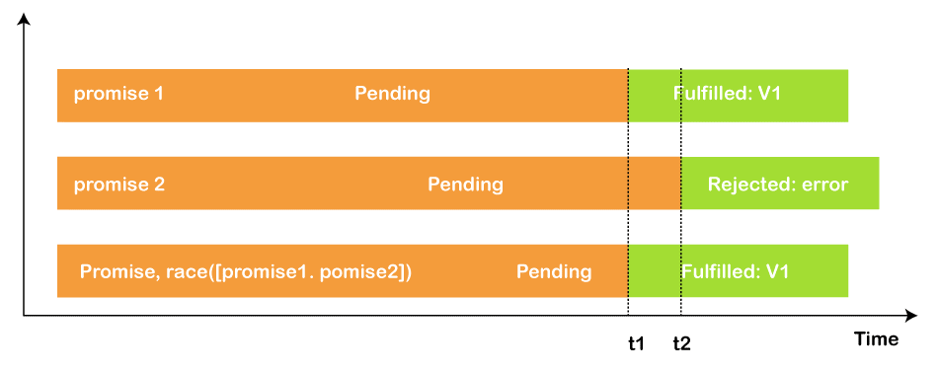
The promise.race() working Diagram

Slide 144
The promise.race() Example
<script>
const pr1 = new Promise((resolve, reject) => {
setTimeout(resolve, 700, "first promise");
});
const pr2 = new Promise((resolve, reject) => {
setTimeout(resolve, 500, "second promise");
});
Promise.race([pr1, pr2]).then((value) => {
document.getElementById('data').innerHTML = value;
});
</script>

Slide 145
Daily Quiz(Cont..)
Q 1 Promises are a way to implement asynchronous programming in JavaScript(ES6 which is also known as ECMAScript-6). (True/False)
True
False
Q 2 A Promise acts as a ------------ for future values
Component
Container
Property
Q 3 A Promise can either be rejected or resolved based on the operation outcome.(True/False)
True
False
Q 4 A ---------------programming includes the running of processes individually from the main thread and notifies the main thread when it gets complete
Synchronous
Asynchronous
Procedural
Q 5 In ES6, we can create a Promise by using the Promise() constructor.(True/False)
True
False

Slide 146
Daily Quiz(Cont..)
Q 6 A ------------- is a way to handle the function execution after the completion of the execution of another function.
Setback
Rollback
Callback
Q 7 Promise chaining allows us to control the flow of JavaScript ----------------- operations.
Callback
Setback
Asynchronous
Synchronous
Q 8 By using Promise chaining, we can use the returned value of a Promise as the input to another asynchronous operation(True/False)
True
False
Q 9 A Promise is created when we are sure of whether or not the assigned task will be completed(True/False)
True
False

Slide 147
Daily Quiz(Cont..)
Q 10 A Promise is not always in one of the following states:
fulfilled:
rejected:
pending:
Constructed:
Q 11 Promise chaining is helpful when we have multiple interdependent synchronous functions(True/False)
True
False
Q 12 The-------------- method delivers a promise that is fulfilled or rejected along with the value or justification from each promise in an iterable as soon as that promise is fulfilled or rejected
Promise.all()
Promise.do()
Promise.race()
Q 13 The -------------------- static method accepts a list or iterable of Promises(e.g.: Array) and returns a new Promise that resolves when all Promise in the iterable has resolved or rejects if at least one of the promises in the iterable has rejected.
Promise.race()
Promise.all()
Promise.reject()
Promise.accept()

Slide 148
Daily Quiz(Cont..)
Q 14 -----------------is a simple concept by which we may initialize another promise inside our .then() method and accordingly we may execute our results.
Constructor Chaining
Promise Chaining
Destructive Chaining
Q 15 A Promise is executed by using the .then() method written after the declared promise.(True/False)
True
False
Q 16 Any promise successfully fulfilled or rejected at the --------------- will be carried out first.
Inset
Outset
Callback
Q 17 The results of the other promises won't be shown as an output, so we might think of this particular method in the form of a real-life example where several people are running in a race, and whoever wins comes first wins the race.(True/False)
True
False
Can Not say

Slide 149
Daily Quiz(Cont..)
Q 18 The second one is reject() which is responsible for the unsuccessful completion of an operation, and we can pass on text inside it.(True/False)
True
False
Q 19 Promise chaining is helpful when we have multiple interdependent asynchronous functions(True/False)
True
False
Q 20 We can declare the promise by using the following syntax.
let promise = new Promise((resolve , reject)=>{
resolve('Hello JavaScript !');
});
True
False

Slide 150
Weekly Assignment
Where can we place JavaScript ? [CO4]
Explain screen output and keyboard input method in JavaScript. [CO4]
Define instance of operator in JavaScript. [CO4]
Explain various datatypes used in JavaScript. [CO4]
Write a JavaScript to find factorial of a number.[CO4]
What is a DTD ? Mention its types. [CO4]
What are composite datatypes in Java Script ? [CO4]
What are the different levels of headings in HTML ? [CO4]
How to create date object in JavaScript ? Explain any four methods of JavaScript date object. [CO4]
What are the different ways that we can include JavaScript to a XHTML document. [CO4]

Slide 151
MCQ s
Q 1 Which of the following methods/operation does JavaScript use instead of == and !=?
JavaScript uses equalto()
b) JavaScript uses equals() and notequals() instead
c) JavaScript uses bitwise checking
d) JavaScript uses === and !== instead
Q 2 Why is JavaScript Engine needed?
Both Compiling & Interpreting the JavaScript
b) Parsing the JavaScript
c) Interpreting the JavaScript
d) Compiling the JavaScript
Q 3 What would be the result of 2+5+”3″?
5
7
73
37

Slide 152
MCQs(Cont..)
Q 4. Java script is an _______ language?
(A) object oriented
(b) object base
© procedural
(d) None of these
Q 5.Which of the following keywords is used to define a variable in JavaScript?
(a) let
(b) var
(C) both A & B
(d) None of the above
Q 6.How can a datatype be declared to be constant type ?
(A) var
(b) const
© let
(D) constant

Slide 153
MCQs(Cont..)
Q 7 .Java script is ideal to
(A)make computations in HTML simpler
(B) minimize storage requirements on the web server
(c) increase the download time for the client
(D) none of the mentioned
Q 8 .The basic difference between javascript & java is
(A)There is no difference
(B). Functions are considered as fields
©. Variables are specific
(D). Functions are values, and there is no hard distinction between methods and fields
Q 9 . Which of the following is not javascript framework?
Node
Vue
React
Cassandra

Slide 154
MCQs(Cont..)
Q 10. Arrays in JavaScript are defined by which of the following statements?
It is an ordered list of values
It is an ordered list of objects
It is an ordered list of string
It is an ordered list of functions
Q 11.Which of the following is not JavaScript data types?
Null type
Undefined type
Number type
All of the mentioned
Q 12.Where is Client-side JavaScript code is embedded within HTML documents? a) A URL that uses the special javascript:code b) A URL that uses the special javascript:protocol c) A URL that uses the special javascript:encoding d) A URL that uses the special javascript:stack

Slide 155
MCQ s(Cont..)
Q 13. Name some of the JavaScript Frameworks?
Angular
React
Vue
All of them
Q 14 In how many ways a JavaScript code can be involved in an HTML file?
Inline
Internal
External
All of them
Q 15 List out the different ways an HTML element can be accessed in a JavaScript code.
getElementById(‘idname’): Gets an element by its ID name
getElementsByClass(‘classname’): Gets all the elements that have the given class name.
getElementsByTagName(‘tagname’): Gets all the elements that have the given tag name.
querySelector(): This function takes CSS style selector and returns the first selected element.
All of them.

Slide 156
MCQ s(Cont..)
Q 16 For largest level of heading which tag is used? A) <h1> B) <h6> C) <heading> D) <head> Q 17 API stands for
a)Application Programming Interface
b) Application Programming Index
c) Applet Programming Interface
(d) None of these
Q 18 For handling user interaction ___side scripting is useful
Server
b)Client
c)Server & Client
d) None of these

Slide 157
MCQ s(Cont..)
Q 19 What is the prototype represents in the following JavaScript code snippet?
function javascript() {};
a) Not valid
b) Prototype of a function
c) Function javascript
d) A custom constructor
Q 20 Why event handlers is needed in JS?
a) Allows JavaScript code to alter the behaviour of windows
b) Adds innerHTML page to the code
c) Change the server location
d) Performs handling of exceptions and occurrences

Slide 158
Glossary Questions
JAD stands for
Joint Application Development
Joint Application Difference
Joint Application Demo
none of these
Java script is scripting language introduce by
IE
Microsoft
Netscape
SunJava
___ operator calculates the remainder by dividing two integers.
/ b) rem c) ^ d) %

Slide 159
Glossary Questions
Which tag is used for smallest heading ……………… protocol stack.
Marquee tag has following attributes
a)behavior
b)direction
c)position
d)both a and b.
The word internet stands for ____
International Network
b) Internal Network
c) Intermediate Network
d) none of these
_____ is used to create a new paragraph
(a) <from> (b) <img> (c) <p> (d)< marque>

Slide 160

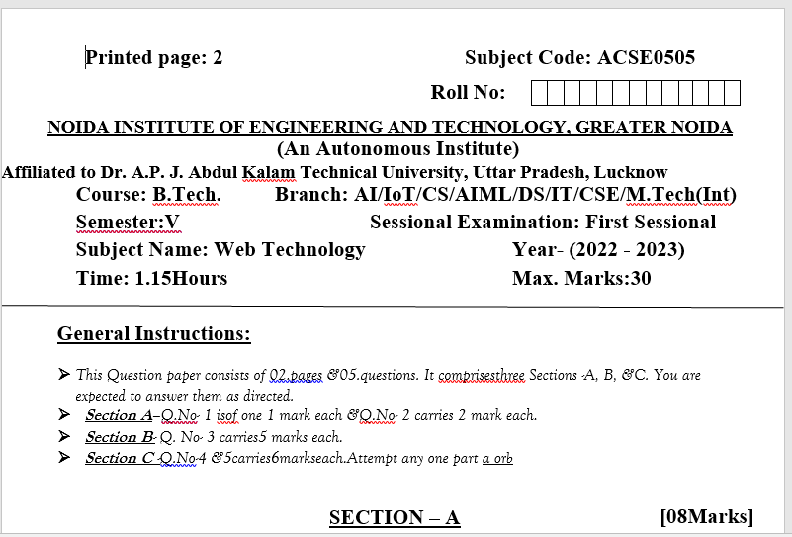
Sessional Papers

Slide 161
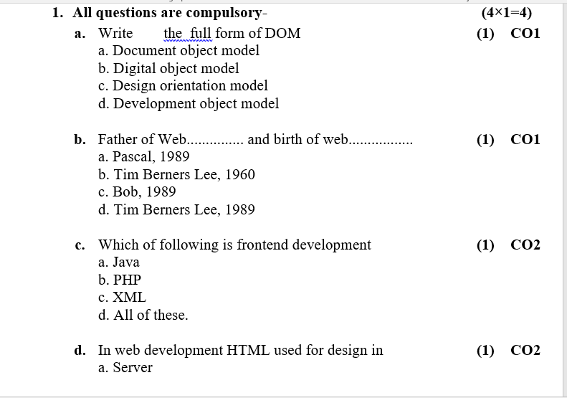
Sessional Papers

Slide 162
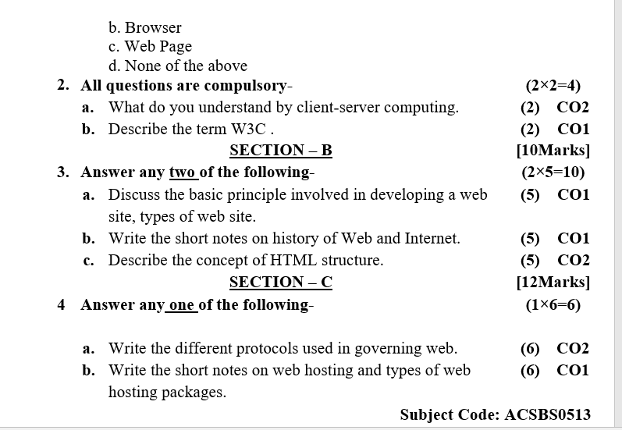
Sessional Papers

Slide 163
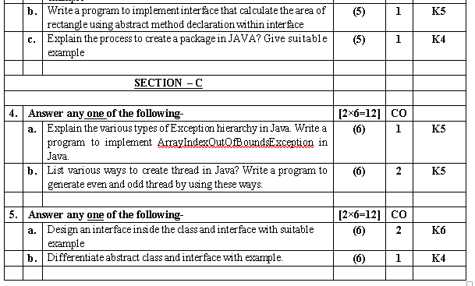
Sessional Papers

Slide 164
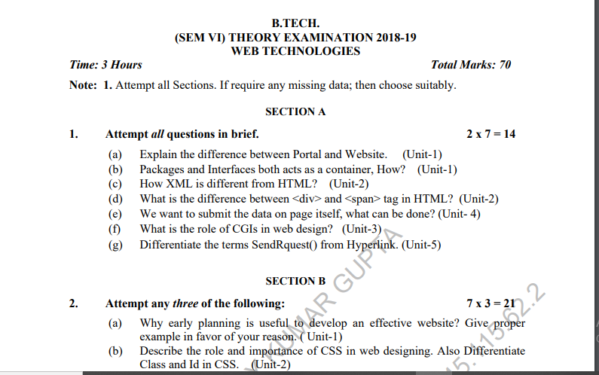
Old Question Paper

Slide 165
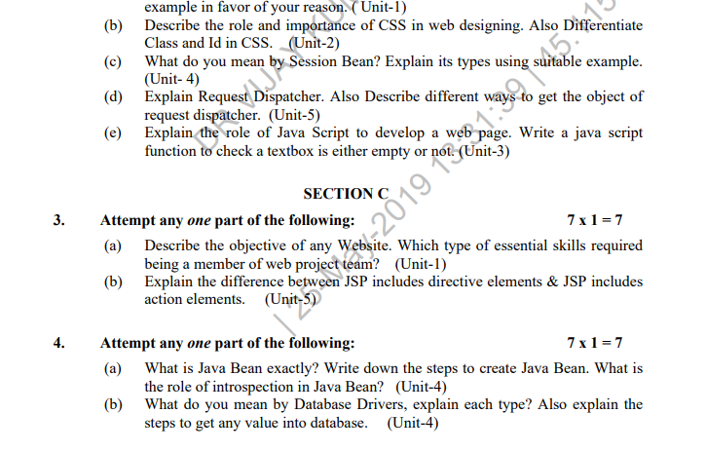
Old Question Paper(cont..)

Slide 166
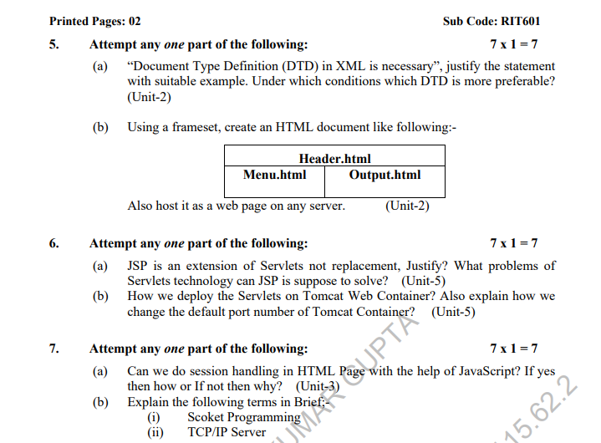
Old Question Paper(cont..)

Slide 167
Expected Questions for University Exam
Explain the importance of JavaScript. Write a java script to manipulate array
Explain relational, logical and athematic operators.
Explain if-else statement in java script with examples.
Write a java Script for counting Odd, even and prime numbers from 1 to 100
Write a java script to calculate the area of the triangle
Write a java script to find factorial of given number.
If a=10 and b=20 write a java script to swapping of these two numbers
Write a script to display sum of first 10 numbers
write a java script to validate phone number

Slide 168
Expected Questions for University Exam
Write a Java Script to calculate the average of three numbers.
Write a java script for finding the greater number between two numbers.
Write a Java Script for on change event.
Which java script operator calculates the remainder by dividing two integers.
Which tag is used for smallest heading .
which tag is used to left align the content is table cell.
which tag is used to left align the content is table cell.

Slide 169
References
Burdman, Jessica, “Collaborative Web Development” Addison Wesley
Xavier, C, “ Web Technology and Design” , New Age International
Ivan Bayross,” HTML, DHTML, Java Script, Perl & CGI”, BPB Publication

Slide 170
Recap of Unit 4
Covered What is JavaScript how JavaScript is different than HTML,CSS.
Covered variables, constant, keywords, operators etc.
Discussed various java script objects, function , function parameters, function arguments etc.
Covered JS script loop, js popup boxes, JS event etc.
Discussed JS array, strings, strings method etc.

Slide 171
NPTEL video / Other study links
Unit 1 | https://youtu.be/96xF9phMsWA
 | https://youtu.be/Zopo5C79m2k
 | https://youtu.be/ZliIs7jHi1s
 | https://youtu.be/htbY9-yggB0
Unit 2 | https://youtu.be/vHmUVQKXlVo
 | https://youtu.be/qz0aGYrrlhU
Unit 3 | https://youtu.be/1Rs2ND1ryYc
Unit 4 | https://youtu.be/-qfEOE4vtxE
 | https://youtu.be/PkZNo7MFNFg
Unit 5 | https://youtu.be/_GMEqhUyyFM

Slide 172
Thank You

